Slide 1
Ecosystem-Insurance

Slide 2
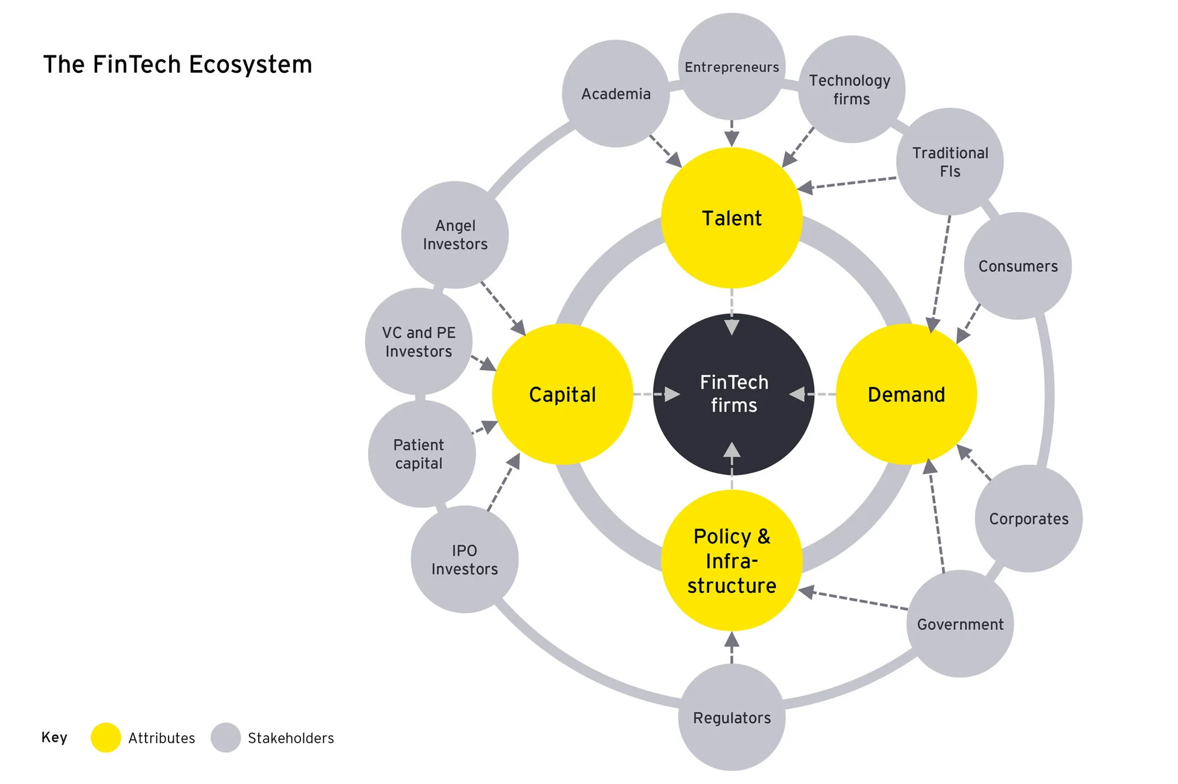

Slide 3
Insurance companies provide a wide range of coverage options to meet different needs, including:
Health Insurance: Covers medical expenses.
Life Insurance: Provides financial protection for beneficiaries.
Auto Insurance: Covers vehicle-related damages and liabilities.
Property Insurance: Protects homes, buildings, and belongings.
Liability Insurance: Covers legal and financial responsibilities.

Slide 4
The Insurance Process
Premium Collection
Policyholders pay regular premiums (monthly, quarterly, or annually).
These payments form the primary revenue source for insurance companies.
Risk Pooling and Fund Management
Collected premiums are pooled into a common fund.
This fund is used to pay out claims to policyholders experiencing covered losses.
Claims and Compensation
When a covered loss occurs, the policyholder files a claim.
The insurance company investigates and, if valid, provides compensation.
Risk Transfer Mechanism
Insurance allows individuals or businesses to shift financial risks to the insurer.
In return for premiums, insurers take on the financial responsibility for covered risks.
The Law of Large Numbers
Insurers spread risk across a large, diverse group of policyholders.
This ensures that they have sufficient funds to cover claims while remaining financially stable.

Slide 5
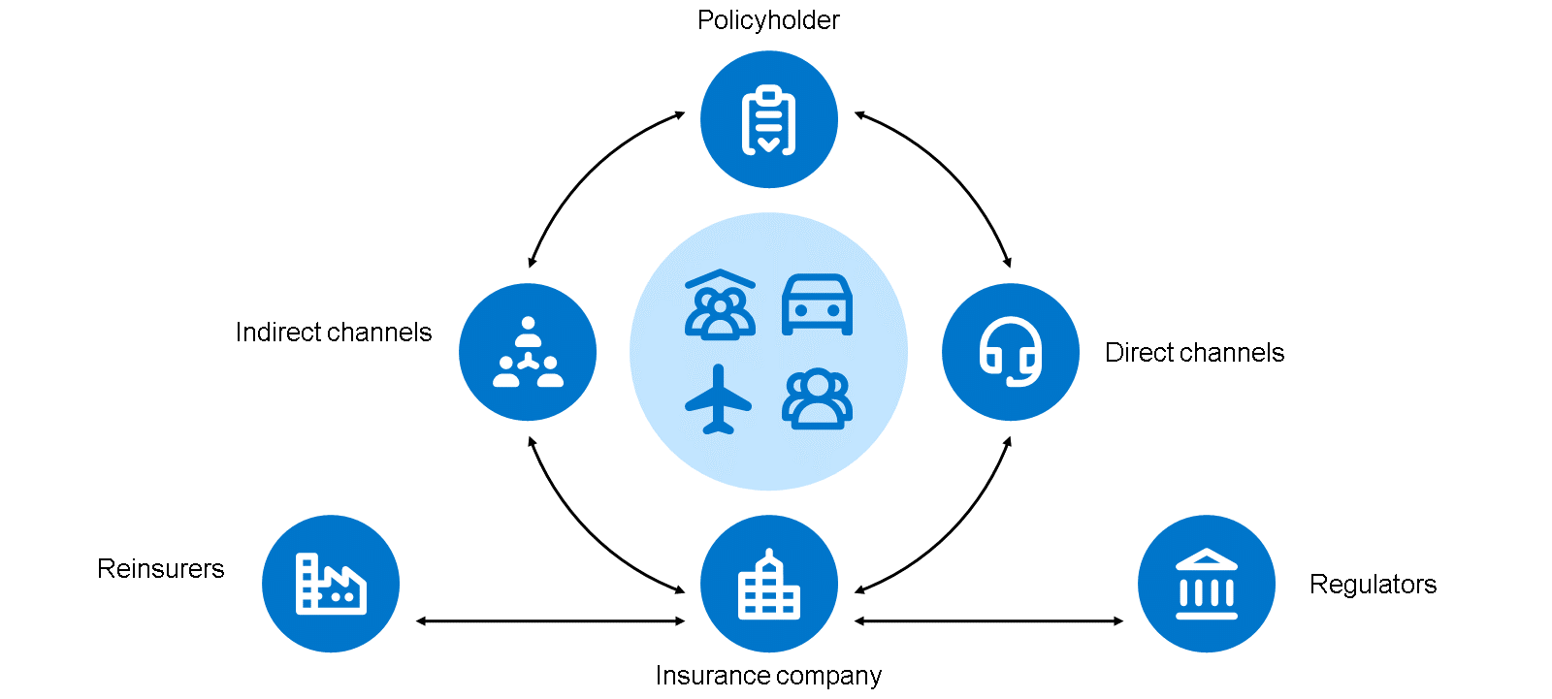
Key Components of the Insurance Ecosystem

Slide 6
Policyholders (The Insured)
Individuals or businesses that purchase insurance policies to protect against financial risks.
Policies are issued by insurance companies, also known as carriers.
Distribution Channels
Indirect Channels (Intermediaries):
Agents (captive or independent) and brokers play a crucial role in selling insurance policies.
They provide personalized advice, compare options, and help customers choose the best coverage.
Direct Channels:
Some insurers sell policies directly without intermediaries.
Sales occur through call centers, online platforms, and banks.

Slide 7
Reinsurers (Risk Mitigation Partners)
Reinsurance companies help primary insurers manage and mitigate risks.
This ensures financial stability and allows insurers to expand their capacity to underwrite policies.
Regulators (Industry Oversight)
Regulatory bodies oversee insurance companies to ensure fairness, transparency, and legal compliance.
Their goal is to protect policyholders, maintain industry stability, and promote fair competition.
This interconnected system enables the insurance company to function efficiently, ensuring financial protection for individuals and businesses while managing risks effectively.

Slide 8
Decoding the Significance of Ecosystems in Insurance
Samantha Chow excellently describes a digital insurance ecosystem as a collaborative network of companies that collectively provides greater value to customers than a single entity could.
The strength of ecosystems lies in their capability to harness each participant's unique strengths, thereby enhancing the customer experience.
Within an ecosystem, insurers collaborate with different partners who offer complementary products, services, and features.
This expands their range of services beyond traditional insurance products, enabling them to reach new customer segments, launch innovative products, and break into new markets.

Slide 9
Embracing Ecosystems: An Opportunity
Ecosystems signify a strategic deviation from traditional business models, offering a genuine potential for market disruption.
Rather than falling prey to it, insurance companies can either join existing ecosystems or create their own to ensure that they are the disruptors, not the disrupted.
As orchestrators of these ecosystems typically control the majority of the revenue, it can be profitable to assume this role.

Slide 10
More than 75% of global insurance executives see digital ecosystems and partnerships as crucial to gaining a competitive edge, as per a 2019 Swiss Re study.
According to EY's "Ecosystems in Insurance: what winners do differently", ecosystems can assist insurers in navigating several crucial trends, including rising customer expectations, profound technology disruption, and widening talent gaps.

Slide 11
Why Swiss Insurers Are Motivated to Embrace Ecosystems
A comprehensive study by ZHAW, Synpulse, and Zühlke indicates that Swiss insurers could be prepping for significant changes and that the existing state of technology modernization looks like a preparation.
At present, digital insurance technologies are focused on specific areas, like replacing legacy systems, process automation, or deploying task-specific tools and interfaces.
Though crucial, these advancements merely set the stage for potential industry transformation, shifting from optimizing present business models to exploring and unleashing new ones.
Several motivating factors have been identified that drive insurers toward ecosystem participation include customer retention through value-added services, acquiring new customers over novel sales channels, fostering innovation by accessing fresh ideas.

Slide 12
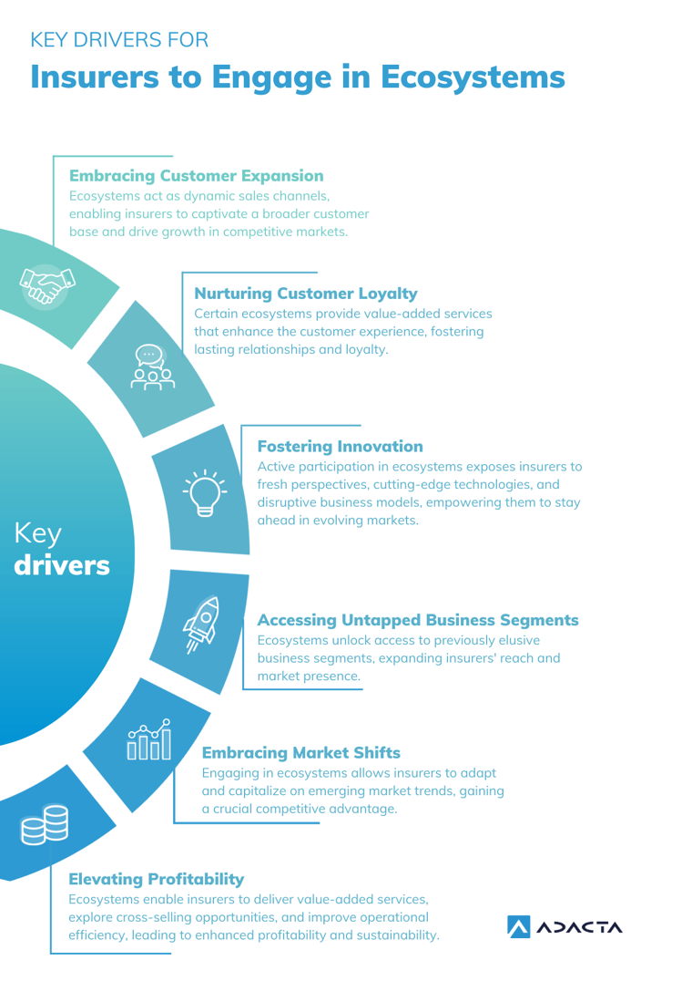

Slide 13
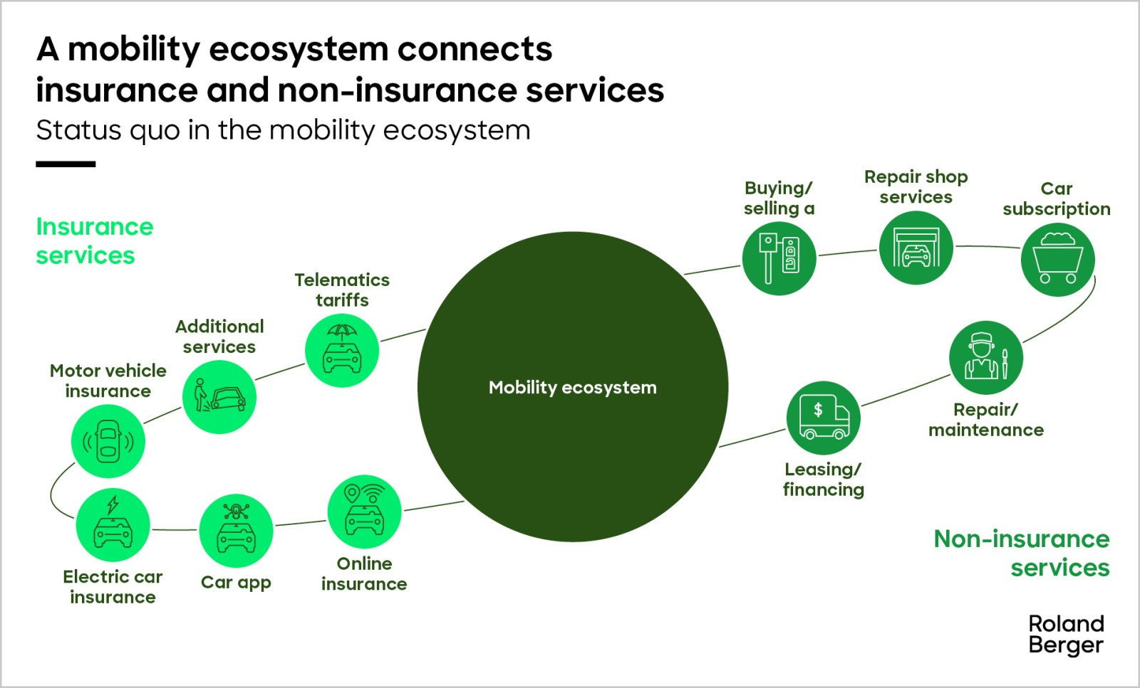
Eco system in Insurance

Slide 14
Roles of the participant’s in ecosystem
Orchestrator
Realizer
Enabler

Slide 15
Orchestrator
Orchestrators are the most outwardly visible players.
They are responsible for formulating a vision, providing technical platforms and creating structures.

Slide 16
Realizer
Realizers, on the other hand, are players who deliver products and services and thus create an actual ecosystem out of a provider's infrastructure or product.
They manage customer relationships.

Slide 17
https://www.youtube.com/watch?v=xjLJwd-PZjI
https://www.youtube.com/watch?v=opFAIWl2b6M

